Slide 1
CIS9660: Data Mining for Business Analytics 4. Classification using Decision Trees
Foster Provost and Tom Fawcett. 2013. Data Science for Business: What you need to know about data mining and data-analytic thinking. O'Reilly Media. Chapter 3,5)
Notes:
Today, we are going to talk about our first major analytics topics, decision trees. We are going to talk about the basic concept of this model and learn how to do this analysis with Rstudio.
From the title, we can see, we use decision tree for what? Classification.

Slide 2
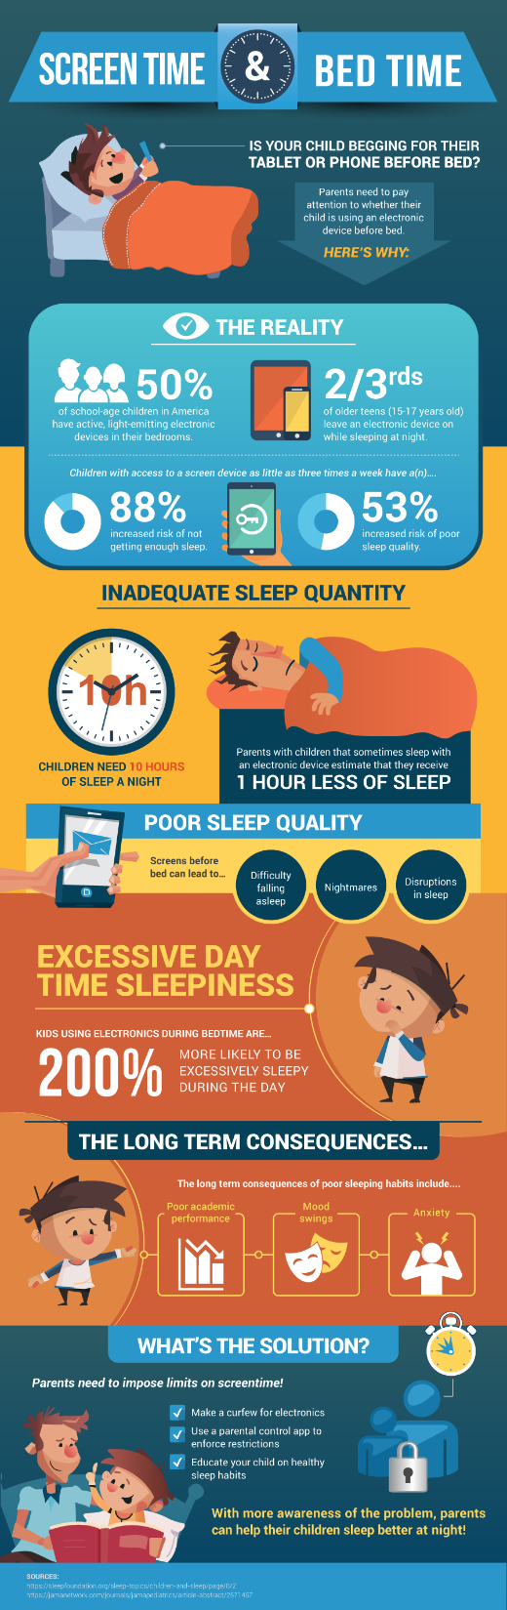
What to include in the group project?
Title
Motivation (1~2 page): Describe the questions to be answered and why is this interesting
Theory or logic of an expected result (1~2 page)
Data: Model-free evidence (1~2 page): Summary statistics to describe show model-free evidence to answer the research question
Analysis (1~3 page)
Results discussion and Implication (1~2 page)
Limitation of your analysis and how to improve the analysis in the future (1~2 page)
How your project would be evaluated?
Graphic (5 points)
Clarity (how well the graphic stands on its own without additional explanation)
Analysis (10 points)
Robustness of analysis (5 points)
Innovation and depth of analysis (5 points)
Notes:
Title: questions to answer
Describe the questions to be answered or the purpose of the analysis
Statistics to describe a phenomena
Consequences of inadequate sleep quality (why is it important?)
Solutions

Slide 3

What is Classification?
A statistical method used to identify to which of a set of categories (or “subpopulations”) a new observation belongs
On the basis of a training dataset containing observations of which categories were known

Slide 4
What is Classification?
Examples
Task | Observations | Outcome (Categories)
Determine which customers are likely to leave the company once their contracts expire | Customers | Leave vs. stay
Categorizing news stories as finance, weather, sports, etc. | News stories | News categories
Determine whether a picture is a dog | Images | Dog vs. not dog
Determine whether a person falls in a video | Video images | Fall vs. not fall

Slide 5
How Classification Works
1
2
3
4
5
Choose a categorical outcome variable
Split the data set into training and validation subsets
Use the training set to find a model that predicts the outcome as a function of the other attributes
Test the model with the validation set to check accuracy
Apply the final model to future cases (i.e. prediction)

Slide 6

How Classification Works
Training Set
TID | Income | Debt | Owns/ Rents | Outcome
1 | 25k | 35% | Owns | Default
2 | 35k | 40% | Rent | Default
3 | 33k | 15% | Owns | No default
4 | 28k | 19% | Rents | Default
5 | 55k | 30% | Owns | No default
6 | 48k | 35% | Rent | Default
7 | 65k | 17% | Owns | No default
8 | 85k | 10% | Rents | No default
…
Construct model
Classification software
Validation Set
TID | Income | Debt | Owns/ Rents | Outcome | Predicted outcome
1 | 80k | 35% | Rent | Default | ?
2 | 20k | 40% | Owns | Default | ?
3 | 15k | 15% | Owns | No default | ?
4 | 50k | 19% | Rents | Default | ?
5 | 35k | 30% | Owns | No default | ?
Test model

Slide 7
What is Decision Tree?
A “divide-and-conquer” approach to the problem of learning from a set of independent instances leads naturally to a style of representation called a decision tree.
Nodes in a decision tree involve testing a particular attribute.
If the attribute at a node is a nominal one, the number of children is usually the number of possible values of the attribute.
If the attribute is numeric, the test at a node usually determines whether its value is greater or less than a predetermined constant, giving a two-way split.
Leaf nodes give a classification that applies to all instances that reach the leaf.

Slide 8
Build Decision Tree with Training Data
Training Set
TID | Income | Debt | Owns/ Rents | Outcome
1 | 25k | 35% | Owns | Default
2 | 35k | 40% | Rent | Default
3 | 33k | 15% | Owns | No default
4 | 28k | 19% | Rents | Default
5 | 55k | 30% | Owns | No default
6 | 48k | 35% | Rent | Default
7 | 65k | 17% | Owns | No default
8 | 85k | 10% | Rents | No default
…
Credit Approval
Income <40k
Income >40k
Debt > 20%
Rents
Debt > 20%
Debt < 20%
Owns house
Rents
Owns house
Debt < 20%
Default
No Default
Default
No Default
Default
No Default
Construct model
Validation Set
TID | Income | Debt | Owns/ Rents | Outcome | Predicted outcome
1 | 80k | 35% | Rent | Default | ?
2 | 20k | 40% | Owns | Default | ?
3 | 15k | 15% | Owns | No default | ?
4 | 50k | 19% | Rents | Default | ?
5 | 35k | 30% | Owns | No default | ?
Test model

Slide 9
Build Decision Tree with Training Data
Predictors
Classification
Child node
Leaf node
TID | Income | Debt | Owns/ Rents | Outcome
1 | 25k | 35% | Owns | Default
2 | 35k | 40% | Rent | Default
3 | 33k | 15% | Owns | No default
4 | 28k | 19% | Rents | Default
5 | 55k | 30% | Owns | No default
6 | 48k | 35% | Rent | Default
7 | 65k | 17% | Owns | No default
8 | 85k | 10% | Rents | No default
…
Root node
Credit Approval
Income <40k
Income >40k
Debt > 20%
Rents
Debt > 20%
Debt < 20%
Owns house
Rents
Owns house
Debt < 20%
Default
No Default
Default
No Default
Default
No Default
Training Set

Slide 10
Test Decision Tree with Validation Data
Validation Set
Credit Approval
Income <40k
Income >40k
Debt > 20%
Rents
Debt > 20%
Debt < 20%
Owns house
Rents
Owns house
Debt < 20%
Default
No Default
Default
No Default
Default
No Default
TID | Income | Debt | Owns/ Rents | Outcome | Predicted outcome
1 | 80k | 35% | Rent | Default | Default
2 | 20k | 40% | Owns | Default | Default
3 | 15k | 15% | Owns | No default | No default
4 | 50k | 19% | Rents | Default | No default
5 | 35k | 30% | Owns | No default | Default
How well did the decision tree do in predicting the outcome?
When it’s “good enough,” we’ve got our model for future decisions.

Slide 11
Classification Accuracy: How often does a tree make a correct prediction with validation data?
Test Decision Tree with Validation Data
Error rate: Misclassified records as % of the total records
Correct classification rate: Correctly classified records as % of the total records
Error rate + Correct classification rate = 100%
A good decision tree model should have high classification accuracy, meaning
Low error rate
High correct classification rate

Slide 12
Classification Accuracy: A Numerical Example
A Confusion Matrix compares the predicted outcomes to the observed (actual) outcomes
 |  | Predicted outcome:
 |  | Default | No default
Observed outcome: | Default | 600 | 100
 | No default | 150 | 650 | Total: 1500
Error rate = (150+100) /1500= 16.7%
Correct classification rate = (1-16.7%) = 83.3%
(Another way to compute:
Correct classification rate = (600+650)/1500 = 83.3%)

Slide 13
Use Decision Tree to Predict with New Data
Credit Approval
Income <40k
Income >40k
Debt > 20%
Rents
Debt > 20%
Debt < 20%
Owns house
Rents
Owns house
Debt < 20%
Default
No Default
Default
No Default
Default
No Default
New Data Set
TID | Income | Debt | Owns/ Rents | Predicted outcome
1 | 50k | 55% | Rent | ?
2 | 25k | 40% | Owns | ?
3 | 15k | 30% | Owns | ?
4 | 50k | 19% | Owns | ?
5 | 65k | 30% | Owns | ?

Slide 14

Advantages of Decision Trees:
Simple to understand, visualize, and interpret
Require relatively less effort from users for data preparation
Automatically perform variable screening or feature selection
Non-linear relationships between the different parameters do not affect the performance of the tree

Slide 15
Disadvantages of Decision Trees:
Over Fitting is one of the most practical difficulty for decision tree models
Provide less information on the relationship between the predictors and the response.
Do not handle continuous variables well
Can be unstable because small variations in the data might result in a completely different tree being generated

Slide 16
How the Algorithm Works
Start with single node with all training data
Yes
Are samples all of same classification?
No
No
Are there predictor(s) that will split the data?
Yes
Partition node into child nodes according to predictor(s)
No
Are there more nodes (i.e., new child nodes)?
DONE!
Yes
Go to next node.

Slide 17
How to Specify the Attributes to Split?
Depends on attribute types
Nominal
Ordinal
Continuous
Depends on number of ways to split
Binary split
Multi-way split

Slide 18
Split over Nominal Attributes
Multi-way split: Use as many partitions as distinct values.
Binary split: Divides values into two subsets.
Property Type
Apartment
Town house
Single house
Property Type
Apartment
House

Slide 19
Split over Ordinal Attributes
Multi-way split: Use as many partitions as distinct values.
Binary split: Divides values into two subsets.
Grade
A
C
B
Grade
Grade
A
<A
OR
>=B
<B

Slide 20
Split over Continuous Attributes
Multi-way split: Discretization to form an ordinal categorical attribute
Static – discretize once at the beginning
Dynamic – ranges can be found by equal interval bucketing, equal frequency bucketing (percentiles), or clustering.
Binary split: (A < v) or (A ≥ v)
consider all possible splits and finds the best cut
can be more compute intensive
Income
Does it make sense to split over every numerical value?
>100k
<50k
100K~50k
Income
>=100k
<100k

Slide 21
How to Choose the Best Attribute for Splitting
Technically, we would like the resulting groups to be as pure as possible. By pure we mean homogeneous with respect to the target variable.
Each time, the algorithm examines each predictor variable and all possible split values for each variable to find the best split.
Predictors: male or not male, high school or not high school, etc…
Split values for one variable: whether income is higher than 40k, 50k, 100k…
There are statistics (e.g., Gini impurity) that show which predictor variable produces the greatest “separation” in the outcome variable
Goal: partition with uniform category — pure leaf
Attributes rarely split a group perfectly
https://www.researchgate.net/figure/48204326_fig2_Figure-2-a-Toy-classification-dataset-b-Resulting-decision-tree

Slide 22
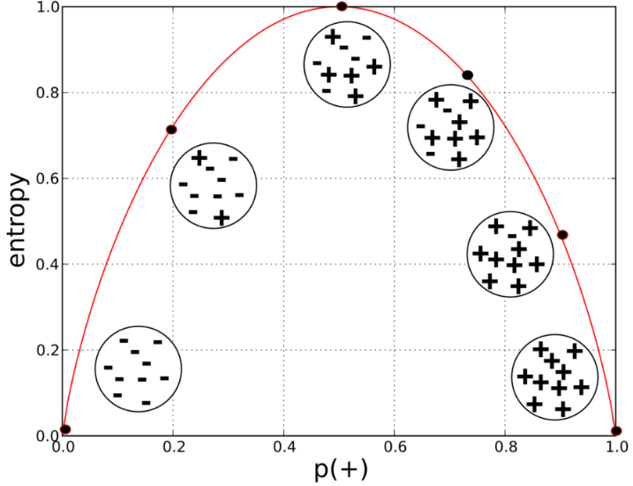
How to Choose the Best Attribute for Splitting
The most common splitting criterion is called information gain (IG), and it is based on a purity measure called entropy
Entropy is a measure of disorder
Entropy is defined as:
Each p_{i} is the probability (the relative percentage) of property i within the set, ranging from p_{i} = 1 when all members of the set have property i, and p_{i} = 0 when no members of the set have property i.
The … simply indicates that there may be more than just two properties (and for the technically minded, the logarithm is generally taken as base 2).
Entropy measures the general disorder of the set, ranging from zero at minimum disorder (the set has members all with the same, single property) to one at maximal disorder (the properties are equally mixed).

Slide 23

How to Choose the Best Attribute for Splitting
Information gain measures the change in entropy due to any amount of new information being added
Strictly speaking, information gain measures the change in entropy due to any amount of new information being added;
In the context of decision tree, let’s call the original set of examples the parent set, and the result of splitting on the attribute values the k children sets. Thus, information gain is a function of both parent set and of the children resulting from some partitioning of the parent set—how much information has this attribute provided? That dependents on how much purer the children are than the parent.
The entropy for each child (c_{i}) is weighted by the proportion of instances belonging to that child, p(c_{i}).

Slide 24
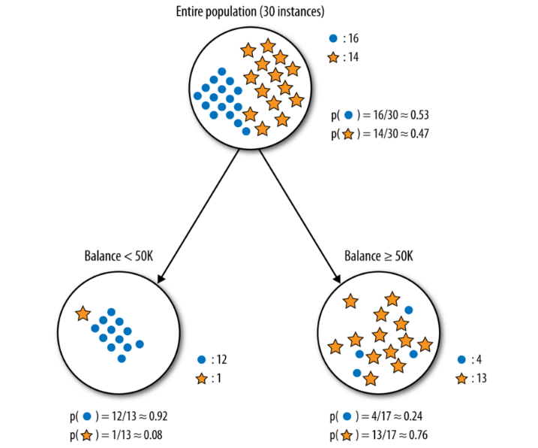
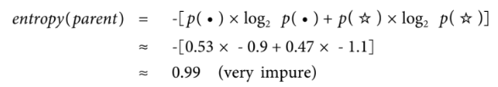
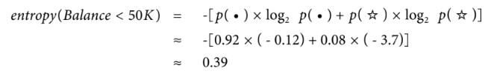
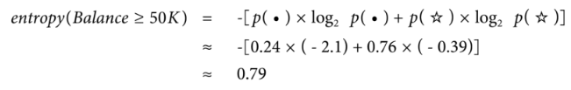
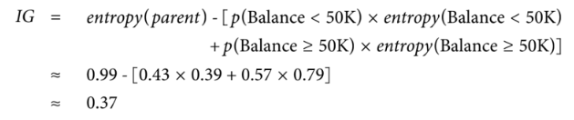
How to Choose the Best Attribute for Splitting
An Example to Calculate Information Gain
So this split reduces entropy substantially. In predictive modeling terms, the attribute provides a lot of information on the value of the target.

Slide 25
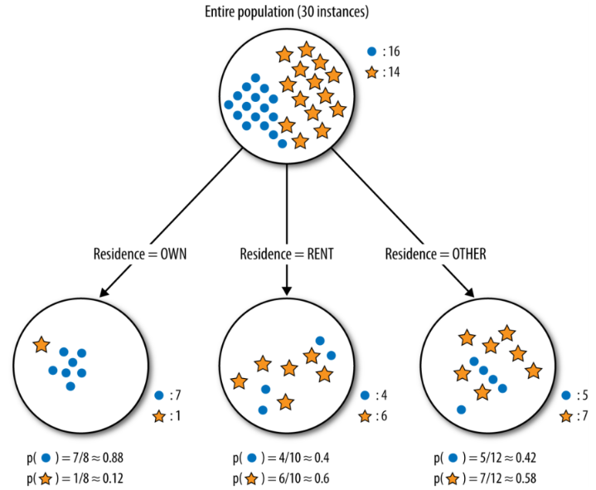
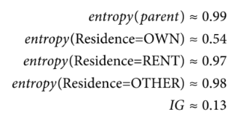
How to Choose the Best Attribute for Splitting
Another Example to Calculate Information Gain
The Resident variable does have a positive information gain, but it is lower than that of Balance (the previous example). Intuitively, this is because, while the one child Resident=OWN has considerably reduced entropy, the other values RENT and OTHER produce children that are no more pure than the parent. Thus, the Resident variable is less informative than Balance.

Slide 26

When to Stop Splitting
Stop expanding a node when all the records belong to the same class
Stop expanding a node when all the records have similar attribute values
Early termination (to be discussed later)

Slide 27
Example to Illustrate

Slide 28
Start with Root Node
There are both “defaults” and “no defaults” in the set
So we need to look for predictors to split the data
Credit Approval

Slide 29
1st Split: Income
Income (with 40k as the cutoff point) is a factor that produces the greatest “separation”
More income, less default
But there are also a combination of defaults and no defaults within each income group
So look for another split
Credit Approval
Income <40k
Income >40k

Slide 30
2nd Split: Debt
Credit Approval
Income <40k
Income >40k
Debt >20%
Debt <20%
Debt >20%
Debt <20%
Debt is a factor
(Income < 40, Debt < 20, Owns = No default) but (Income < 40, Debt < 20, Rents = Default)
But there are also a combination of defaults and no defaults within some debt groups
So look for another split

Slide 31
3rd Split: Housing (Own vs. Rent)
Credit Approval
Income <40k
Income >40k
Debt >20%
Debt <20%
Debt >20%
Debt <20%
Default
Owns house
Rents
No Default
Default
Owns house
Rents
No Default
Default
No Default
Own/Rent is a factor
For some cases it doesn’t matter, but for some it does
So you group similar branches
…And we stop because we’re out of predictors!

Slide 32
The decision tree algorithm takes a large set of training data to compute the tree
In the data:
Similar cases may have different outcomes
So probability of an outcome is computed
Credit Approval
Income <40k
Income >40k
Debt > 20%
Rents
Debt > 20%
Debt < 20%
Owns house
Rents
Owns house
Debt < 20%
Default
No Default
Default
No Default
Default
No Default
0.6
For instance, you may find:
When income > 40k, debt > 20%, and the customers rents, default occurs 60% of the time.

Slide 33
Reading the Decision Tree Result
Outcome cases are not 100% certain
There are probabilities attached to each outcome in a node
So let’s code “Default” as 1 and “No Default” as 0
Credit Approval
Income <40k
Income >40k
Debt >20%
Debt <20%
Debt >20%
Debt <20%
1
Owns house
Rents
0
0
Owns house
Rents
0
1
0
0.85
0.20
How many leaf nodes are there?
0.30
0.22
0.60
0.26

Slide 34
Reading the Decision Tree Result
Outcome cases are not 100% certain
There are probabilities attached to each outcome in a node
So let’s code “Default” as 1 and “No Default” as 0
Value of 1:
we predict that these people are likely to
“Default”
Credit Approval
Income <40k
Income >40k
Debt >20%
Debt <20%
Debt >20%
Debt <20%
1
Owns house
Rents
0
0
Owns house
Rents
0
1
0
0.85
0.20
0.30
0.22
Value of 0:
we predict that these people are likely to “No Default”
0.60
0.26

Slide 35
Reading the Decision Tree Result
Outcome cases are not 100% certain
There are probabilities attached to each outcome in a node
So let’s code “Default” as 1 and “No Default” as 0
Credit Approval
Income <40k
Income >40k
Debt >20%
Debt <20%
Debt >20%
Debt <20%
1
Owns house
Rents
0
0
Owns house
Rents
0
1
0
Numbers next to the leaf nodes:
Represent the probabilities of the predicted outcome being 1 (1=“Default”)
0.85
0.20
0.30
0.22
0.60
0.26

Slide 36
Reading the Decision Tree Result
Outcome cases are not 100% certain
There are probabilities attached to each outcome in a node
So let’s code “Default” as 1 and “No Default” as 0
Credit Approval
Income <40k
Income >40k
Debt >20%
Debt <20%
Debt >20%
Debt <20%
1
Owns house
Rents
0
0
Owns house
Rents
0
1
0
0.85
0.20
For example, for people with income<40K and Debt>20%,
the probability of “default” is 0.85
(or 85%)
0.30
0.22
0.60
0.26

Slide 37
Reading the Decision Tree Result
Outcome cases are not 100% certain
There are probabilities attached to each outcome in a node
So let’s code “Default” as 1 and “No Default” as 0
Credit Approval
Income <40k
Income >40k
Debt >20%
Debt <20%
Debt >20%
Debt <20%
1
Owns house
Rents
0
0
Owns house
0
1
0
Rents
So what is the chance that:
1. A renter making more than $40,000 and debt more than 20% of income will default?
2. A home owner making less than $40,000 and debt less than 20% of income will default?
0.85
0.20
0.30
0.22
0.60
0.26

Slide 38
Reading the Decision Tree Result
Outcome cases are not 100% certain
There are probabilities attached to each outcome in a node
So let’s code “Default” as 1 and “No Default” as 0
Credit Approval
Income <40k
Income >40k
Debt >20%
Debt <20%
Debt >20%
Debt <20%
1
Owns house
Rents
0
0
Owns house
0
1
0
Rents
So what is the chance that:
1. A renter making more than $40,000 and debt more than 20% of income will default?
2. A home owner making less than $40,000 and debt less than 20% of income will default?
0.85
0.20
0.30
0.22
0.60
0.26

Slide 39
Reading the Decision Tree Result
Outcome cases are not 100% certain
There are probabilities attached to each outcome in a node
So let’s code “Default” as 1 and “No Default” as 0
Credit Approval
Income <40k
Income >40k
Debt >20%
Debt <20%
Debt >20%
Debt <20%
1
Owns house
Rents
0
0
Owns house
0
1
0
Rents
So what is the chance that:
1. A renter making more than $40,000 and debt more than 20% of income will default?
2. A home owner making less than $40,000 and debt less than 20% of income will default?
0.85
0.20
0.30
0.22
0.60
0.26

Slide 40
Reading the Decision Tree Result
Outcome cases are not 100% certain
There are probabilities attached to each outcome in a node
So let’s code “Default” as 1 and “No Default” as 0
Credit Approval
Income <40k
Income >40k
Debt >20%
Debt <20%
Debt >20%
Debt <20%
1
Owns house
Rents
0
0
Owns house
Rents
0
1
0
0.85
0.20
Describe the characteristics of the most likely and least likely groups to default.
0.30
0.22
0.60
0.26

Slide 41
Reading the Decision Tree Result
Outcome cases are not 100% certain
There are probabilities attached to each outcome in a node
So let’s code “Default” as 1 and “No Default” as 0
Credit Approval
Income <40k
Income >40k
Debt >20%
Debt <20%
Debt >20%
Debt <20%
1
Owns house
Rents
0
0
Owns house
Rents
0
1
0
0.85
0.20
Describe the characteristics of the most likely and least likely groups to default.
0.30
0.22
0.60
0.26

Slide 42
Evaluation Decision Tree
Single validation:
Split the data into a training and a holdout (validation) set
Build the tree on training data and test the constructed model on test data
Cross-validation:
Split the data into k partitions called folds. Typically, k will be five or ten
Iterate training and testing k times, in a particular way: train the algorithm on k-1 folds while using the remaining fold as the test set (called the “holdout fold”)
You will have performance estimates from all the k holds and compute the average and the standard deviation.

Slide 43
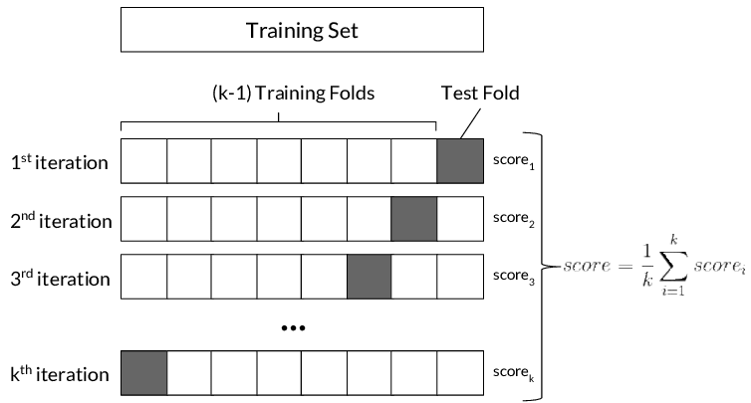
Cross-validation: A graphic illustration

Slide 44
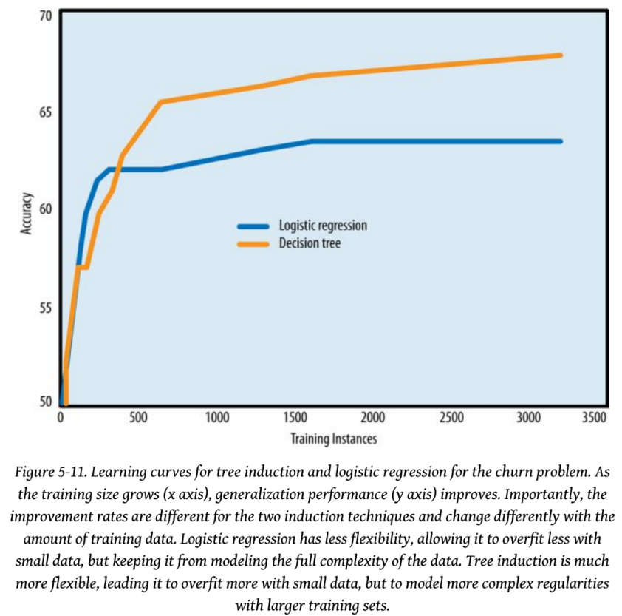
Learning Curve
What is a learning curve?
If the training set size changes, you may expect different generalization from the resultant model.
All else being equal, the generalization performance of data-driven modeling generally improves as more training data become available, up to a point.
A plot of the generalization performace against the amount of training data is called a learning curve.

Slide 45
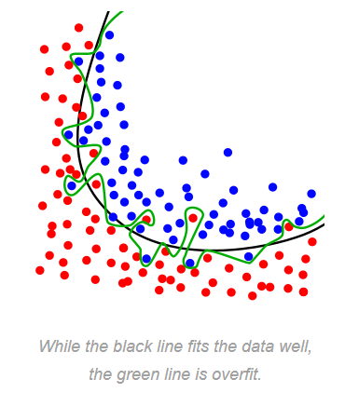
Overfitting
You may get better classification accuracy for the training set
But… the tree will become too complex
Difficult to interpret
Another Problem: “Overfitting”

Slide 46
Why Overfitting Matters
Generalizability versus Overfitting
Generalization is the property of a model or modeling process whereby the model applies to data that were not used to build the model.
Overfitting is the tendency of data mining procedure to tailor models to the training data, at the expense of generalization to previously unseen data points.
As a model gets more complex, it is allowed to pick up harmful spurious correlations which do not represent characteristics of the population in general
If the tree is too complex, it may have poor predictive performance for new data, as it can exaggerate minor fluctuations (noises) in the training data.
“There is a fundamental trade-off between model complexity and the possibility of overfitting.”

Slide 47
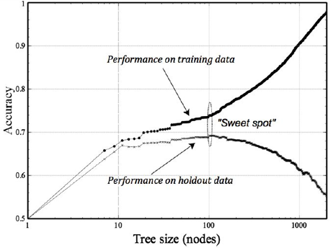
How to recognize overfitting—the fitting graph
Overfitting starts from here

Slide 48
Avoid Overfitting with Tree Induction
Tree induction commonly uses two techniques to avoid overfitting:
Stop growing the tree before it gets too complex:
Stop splitting when the number of instances is less than some user-specified threshold;
Stop splitting when expanding the current node does not improve impurity measures (e.g., information gain).
Grow the tree until it is too large, and then ”prune” it back, reducing its size (and thereby its complexity)
“Prune” the tree

Slide 49
Logistic Regression or Decision Trees for Classification?
Decision Trees | Logistic Regression
Select a single attribute at a time | Use a weighted combination of all attributes
Bisect the space into smaller and smaller regions | Fit a single line to divide the space exactly into two
Better capture the division but can be overfitting | Generalize better
Easy to interpret when the tree size is small | More interpretable if the decision involves a large number of variables

Slide 50
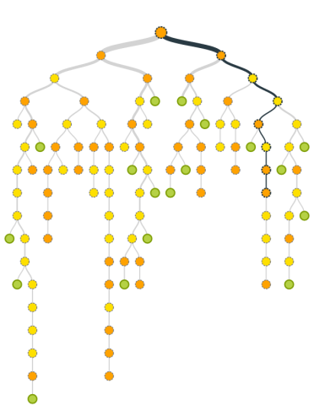
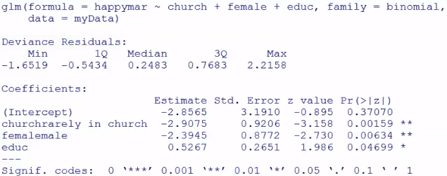
Logistic Regression or Decision Trees for Classification?
No model is perfect
It can be difficult to compare the relative merits of these two methods
When applied to a business problem, there is a difference in the comprehensibility of the models to stakeholders with different backgrounds
Versus

Slide 51
Summary
What is classification
What is decision tree
Structure of a decision tree
Root nodes
Child nodes
Leaf nodes
Information Gain
Classification accuracy
Error rate and correct classification rate
Overfitting and learning curve
Interpret a decision tree
Determine the probability of an event happening based on predictor variable values
Pros and cons of a complex tree

